Slide 1

Windows Azure Overview
Name
Title
Organization

Slide 2

Empower people for the activities they value most . . .
Notes:
Key Statements:
Let’s start with Microsoft Vision – at our core we create amazing experiences to empower people for the activities they care most about.
This is anchored in our family of current and new devices and service for individuals and businesses.
Our assets are very strong – our platform is adaptable to different screen sizes and powered by services meeting people’s needs where ever they are – at home, work, school, and on the go.

Slide 3


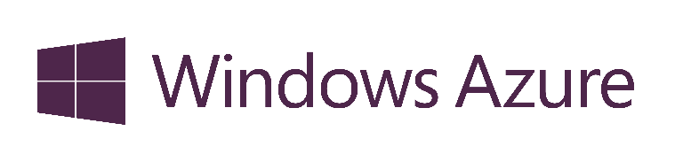







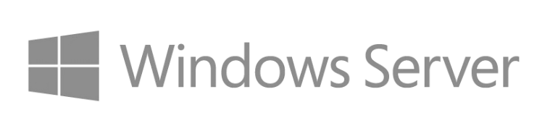


Programming skills
Development tools
Languages, frameworks
Components
Runtimes
Notes:
Key Statements:
Another key attribute of our platform is the concept of common core, which provides unique opportunity for developers. No competitor can match this.
Our Windows platform spans devices and cloud services, including Windows, Windows Phone, Windows Azure, Windows Server, Office, Bing, Xbox, Visual Studio and other tools and technologies.
With common core, developers have the ability to take code, skill set, programming languages, and tools across PC, tablet, phone, and handheld device.
In Enterprise space the deployment choice (public, private, hybrid) and enterprise grade credibility are key tenets for LOB applications.
For commercial developers, on the other hand, the size of potential market combined with faster development paves an easier path to commercial success.

Slide 4



What is the cloud?
An approach to computing that’s about having the right resources at the right time, and connecting to a variety of devices and endpoints.
Run Your Code & Store Your Data
In Microsoft’s Data Centers
Elasticity
Self service
Pay for what you use
Standards based
Notes:
Speaking Points:
There are numerous terms and definitions floating around in the industry for “the cloud”, “cloud computing”, “cloud services”, etc.
Microsoft thinks of the cloud as simply an approach to computing that enables applications to be delivered at scale for a variety of workloads and client devices.
The cloud can help deliver IT as a standardized service…freeing you up to focus on your business

Slide 5



Windows Azure
Comprehensive set of services that enable you to quickly build, deploy and manage applications across a global network of Microsoft-managed datacenters
Flexible
Open
Solid

Slide 6



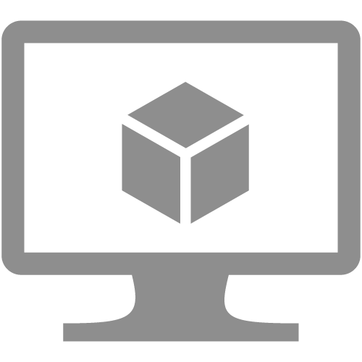


Cloud Computing
IaaS
PaaS
SaaS
Infrastructure-as-a-Service
Platform-as-a-Service
Software-as-a-Service
host
build
consume
Virtual machines
Cloud services
Web sites
Notes:
Slide Objectives:
Explain the three established industry terms for cloud services
Speaker Notes:
There is a lot of talk in the industry about different terms like Platform as a Service, Infrastructure as a Service, and Software as a Service.
Since PDC08 when we first announced the Windows Azure our focus has been on delivering a platform as a service offering where you can build applications. Where the platform abstracts you from the complexities of building and running applications.
We fundamentally believe that the future path forward for development is by providing a platform. In fact, as you’ll see in a few minutes, we believe that there are a number of new capabilities that should be delivered as services to the platform.
Notes:
There is a lot of confusion in the industry when it comes to the cloud.
It’s important that you understand both what is happening in the industry and how we think about the cloud.
This is the most commonly used taxonomy for differentiating between types of cloud services.
The industry has defined three categories of services:
IaaS – a set of infrastructure level capabilities such as an operating system, network connectivity, etc. that are delivered as pay for use services and can be used to host applications.
PaaS – higher level sets of functionality that are delivered as consumable services for developers who are building applications. PaaS is about abstracting developers from the underlying infrastructure to enable applications to quickly be composed.
SaaS – applications that are delivered using a service delivery model where organizations can simply consume and use the application. Typically an organization would pay for the use of the application or the application could be monetized through ad revenue.
It is important to note that these 3 types of services may exist independently of one another or combined with one another.

Slide 7


Cloud Computing
Packaged Software
Infrastructure
(as a Service)
Platform
(as a Service)
Software
(as a Service)
Applications
Applications
You manage
Applications
Applications
Data
You manage
Data
Data
Data
Runtime
Runtime
Runtime
Runtime
Managed by vendor
You manage
Middleware
Middleware
Middleware
Middleware
Managed by vendor
O/S
O/S
O/S
O/S
Virtualization
Virtualization
Managed by vendor
Virtualization
Virtualization
Servers
Servers
Servers
Servers
Storage
Storage
Storage
Storage
Networking
Networking
Networking
Networking
Notes:
Slide Objectives:
Explain the differences and relationship between IaaS, PaaS, and SaaS in more detail.
Speaking Points:
Here’s another way to look at the cloud services taxonomy and how this taxonomy maps to the components in an IT infrastructure.
Packaged Software
With packaged software a customer would be responsible for managing the entire stack – ranging from the network connectivity to the applications.
IaaS
With Infrastructure as a Service, the lower levels of the stack are managed by a vendor. Some of these components can be provided by traditional hosters – in fact most of them have moved to having a virtualized offering.
Very few actually provide an OS
The customer is still responsible for managing the OS through the Applications.
For the developer, an obvious benefit with IaaS is that it frees the developer from many concerns when provisioning physical or virtual machines.
This was one of the earliest and primary use cases for Amazon Web Services Elastic Cloud Compute (EC2).
Developers were able to readily provision virtual machines (AMIs) on EC2, develop and test solutions and, often, run the results ‘in production’.
The only requirement was a credit card to pay for the services.
PaaS
With Platform as a Service, everything from the network connectivity through the runtime is provided and managed by the platform vendor.
The Windows Azure best fits in this category today.
In fact because we don’t provide access to the underlying virtualization or operating system today, we’re often referred to as not providing IaaS.
PaaS offerings further reduce the developer burden by additionally supporting the platform runtime and related application services.
With PaaS, the developer can, almost immediately, begin creating the business logic for an application.
Potentially, the increases in productivity are considerable and, because the hardware and operational aspects of the cloud platform are also managed by the cloud platform provider, applications can quickly be taken from an idea to reality very quickly.
SaaS
Finally, with SaaS, a vendor provides the application and abstracts you from all of the underlying components.

Slide 8

Global Footprint
Notes:
We have also announced datacenter’s in China (first cloud vendor to do so), Japan, and Australia.
Speaking Points:
Windows Azure itself is deployed around the world
With Windows Azure, we have a concept of regions, which is where you choose to place your code and run.
In each of the regions, we have a Microsoft datacenter.
These datacenters are massive facilities that host 10s or in some cases hundreds of thousands of servers
We have currently four regions in North America, two regions in Europe, and two in Aisa
As you can see on this slide we also have a number of CDN edge points, which we can use to cache your content and deliver it even faster for customers. %
What you’re going to see in the next couple months and years is that we will rapidly expand our datacenter footprint around the world, so you will have more options for running your applications.
Once you build an application, you can choose where you want to run in the world and you can move your workloads from region to region.
You can also run your application in multiple regions simultaneously and just direct traffic and customers to whichever version of the app is closest to them.
That gives you a global footprint and a chance to reach a bigger customer base or audience in new markets
Notes:
Windows Azure services such as compute and storage are now available in 8 worldwide datacenters with an additional 24 Content Delivery Network endpoints.
You can’t have a real cloud without a data center.

Slide 9





Free $200 Credit
Go to http://aka.ms/AzureCampsTrial
You will need a credit card
Human test
Will not be charged
Spending Cap
$200 to spend as you want
Cannot go over
30 days
Use it or lose it

Slide 10

Subscriptions
Subscriptions are a unit of billing and control.
Cost is by usage:
500 CPUs in one project == 50 CPUs in 10 projects

Slide 11
Use Multiple Subscriptions
dev
qa
prod
Dev Subscription n (1 per developer)
QA Subscription
Prod. Subscription
App
App
App
Team Foundation Server / Visual Studio Online

Slide 12
It’s not just about code…
There are many ways to enrich your application without having to write much code.
Notes:
Access to BIG IT, democratization, services services services
Bring in authentication from facebook, use something for global caching, global load balance, hadoop big data, etc.

Slide 13

Only write the code that only you can write.
Notes:
Do not spend time writing components or code than anyone can write. Use a good framework, or cloud service to fill that gap. Use your time to build your IP, your unique offering, etc.

Slide 14
Mobile Services
Easily build cloud back-ends
Data, identity, push notifications, and scheduled scripts
Windows Store, Windows Phone, iOS, and Android
Notes:
Speaking Points:
Transition:
So we’ve seen three ways to run your code in Windows Azure - Virtual machines, Web Sites, and Cloud Services
Now let’s look at the fourth compute service called Windows Azure Mobile Services.
Definition
Mobile Services is an exciting new service that we introduced about three months ago and we’ve rapidly been updating with new features and services.
I’m sure that many of you today are building device applications that need connectivity to services and data.
Mobile Services are designed specifically to make it really simply for you to build cloud back-ends that power mobile device applications by providing common functionality you need as configurable services.
Features:
Mobile Services provides the ability to easily store and retrieve data, manage users with several different identify providers including Microsoft Account, Twitter, Facebook, and Google accounts, and the ability to send push notifications to devices.
Today Mobile Services has native SDKs for Windows 8 Store applications, Windows Phone apps, and iOS applications.
We’re also adding Android and HTML5 support in the near future.

Slide 15
SQL database
Relational SQL Server Engine in the Cloud
Clustered for high availability
Fully Managed Service
SQL Reporting support
Notes:
Speaking Points:
Let’s walk through some of the building block services that we’re providing and in particular highlight some of the new features of these services.
If you’ve been using Windows Azure you maybe familiar with some of these services. However, there are several new features we’re enabling with all of them.
The first one I’m going to talk about is the SQL Database
SQL Database is a service we’ve had for a while as part of Windows Azure
It provides a relational SQL Server database engine in the cloud
We run the SQL engine for you, we do all of the clustering and availability work for you, so you don’t have to worry about standing up your own clustered environment.
It’s a fully managed service
We also apply security patches and monitor the system

Slide 16
Cache
Low latency, in-memory distributed cache
Dynamically grow and shrink cache size
High availability support
Memcached protocol support
Notes:
Speaking Points:
We now have a new distributed cache feature in Windows Azure
It is a low latency, in-memory cache that you can stand up as part of our application
It’s elastic so you can dynamically grow or shrink the cache at will, based on how your application is doing
You don’t have to modify any application code or redeploy your application to increase or decrease the cache size.
Instead just go into the portal say you want more roles and Windows Azure will automatically spin them up
It also has high availability support.
So you can indicate when you cache something that you want to pin the data on at least two cache servers, so if there is a hardware failure you will not loose any data.
The Distributed Cache can be used from any language.
It now supports the Memcach’D protocol, so if you have apps that use Memcached today you can simply point them to the new distributed cache and they will work with no code changes required.

Slide 17
Identity
Integrate with enterprise identity
Enable single sign-on within your apps
Enterprise Graph REST API
93% of Fortune 1000 use Active Directory
Notes:
Speaking Points:
You can integrate with anyone using Active Directory
Once you integrate
You can also take advantage of our new graph API

Slide 18
Service bus
Secure messaging and relay capabilities
Easily build hybrid apps
Enable loosely coupled solutions
Notes:
Speaking Points:
We also have a bunch of new service bus capabilities
The Service Bus is a managed service that provides secure messaging and relay capabilities.
It’s great for integrating cloud based solutions with on-premise environments in a very secure way
and it enables a very loosely coupled architecture
With the new Windows Azure SDK and Tools for Visual Studio, you can now view information about the service bus directly from within Visual Studio.
We are also now introducing cross platform libraries so you can use service bus from any OS whether it’s a VM, web site, or Cloud Service and with any of the languages we support.

Slide 19






Windows Azure
Cloud application
Service bus relay
Internet
Enterprise
App behind firewall
Notes:
Speaking Points:
In addition to queues, the Service Bus also provides a relay capability that can be used to connect through networks and enable hybrid applications.
To see this in action, we’ll take a look at another simple scenario.
In this case we have a SQL database in our on-premises environment (for our demo, my local laptop) and the data is exposed through a simple WCF service
By using the Service Bus relay, we can enable connectivity to our WCF service through Windows Azure
On the front end, we have a mobile web application created with ASP.NET MVC running as a Cloud Service in Windows Azure. This app will connect to the WCF service through the relay and serve up the data to users.

Slide 20
Windows Azure Store
Consume services from ecosystem of partners
Easily try and purchase
Billing integrated within your Azure bill
Notes:
Speaking Points:
In addition to the building block services that we provided from Microsoft, at BUILD we also introduced the Windows Azure Store.
Focused on developer services – both for data, storage options, application monitoring, and more.
Many of these services are recognizable startups such as NewRelic and SendGrid

Slide 21










Application building blocks
Big data
Database
Storage
Traffic
Caching
Messaging
Identity
Media
CDN
Networking
Notes:
Speaking Points:
In addition to the compute services for running your deploying and running your code, Windows Azure also provides a number of application building blocks.
These are managed services that we run that provide a lot of value so you can avoid standing up the infrastructure for common capabilities
You always can stand up VMs and put anything you want in it
But in a lot of cases you will find that we have built in services that we deliver or that are delivered by our partners
What’s cool is that you can use any of these services with a VM, with a Web Site, or with a Cloud Service – so you have flexibility in how you will consume them.

Slide 22
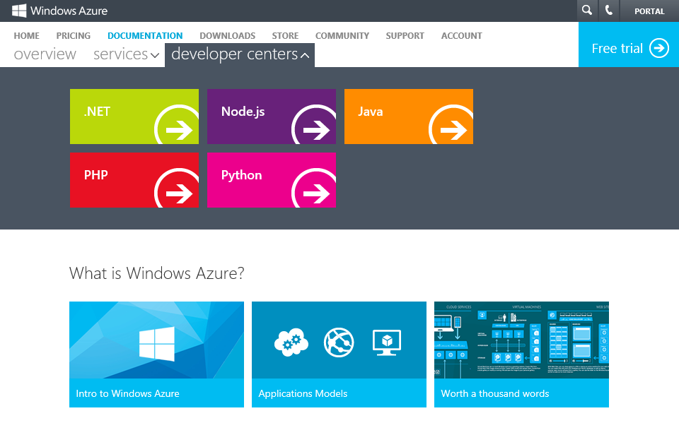
→ http://WindowsAzure.com
Multiple languages
and
Native
tools
Notes:
Speaking Points:
All of these services can also be used from multiple languages
We now have as part of our developer center on WindowsAzure.com support for multiple different languages including .NET, Node, Java, and PHP.
One of the new languages that we’re now enabling is Python with a complete SDK and dev center.
For each of these we provide libraries that you can consume that call into the REST APIs that we expose for the building block services.
You can also call the REST APIs directly

Slide 23
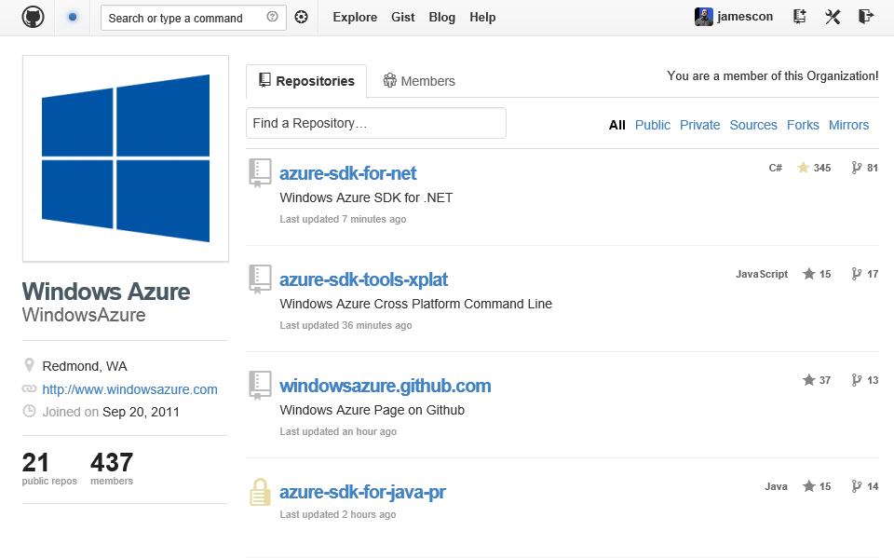
→ http://github.com/windowsazure
Open source
Notes:
Speaking Points:
All of the libraries are hosted on GitHub under an Apache 2 license
So you can both see the source and contribute back to the source

Slide 24
Windows Azure
Demo
Notes:
Demo how to sign up for a trial.
REMEMBER: Credit card is used to validate over 18, and to prove you are a human. It is never billed because the trial account has a spending cap.
Demo the portal. Show the let, the tray, filtering subscriptions, etc. Just the parts you find useful.

Slide 25
Q&A

Slide 26

© 2013 Microsoft Corporation. All rights reserved. Microsoft, Windows, Windows Vista and other product names are or may be registered trademarks and/or trademarks in the U.S. and/or other countries.
The information herein is for informational purposes only and represents the current view of Microsoft Corporation as of the date of this presentation. Because Microsoft must respond to changing market conditions, it should not be interpreted to be a commitment on the part of Microsoft, and Microsoft cannot guarantee the accuracy of any information provided after the date of this presentation. MICROSOFT MAKES NO WARRANTIES, EXPRESS, IMPLIED OR STATUTORY, AS TO THE INFORMATION IN THIS PRESENTATION.

